Slide 1
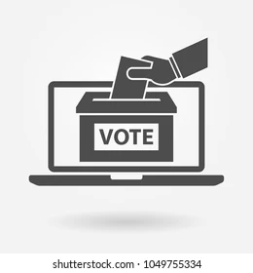
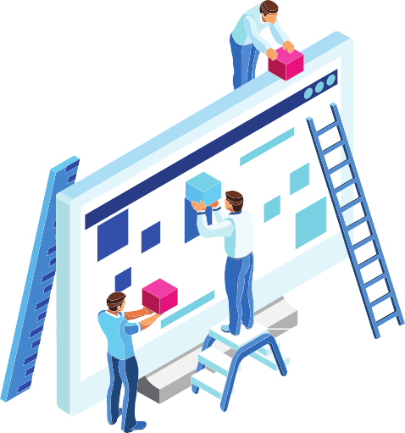

Micro Project
Online Voting System
Presented by:- Shounak Dighe

Slide 2

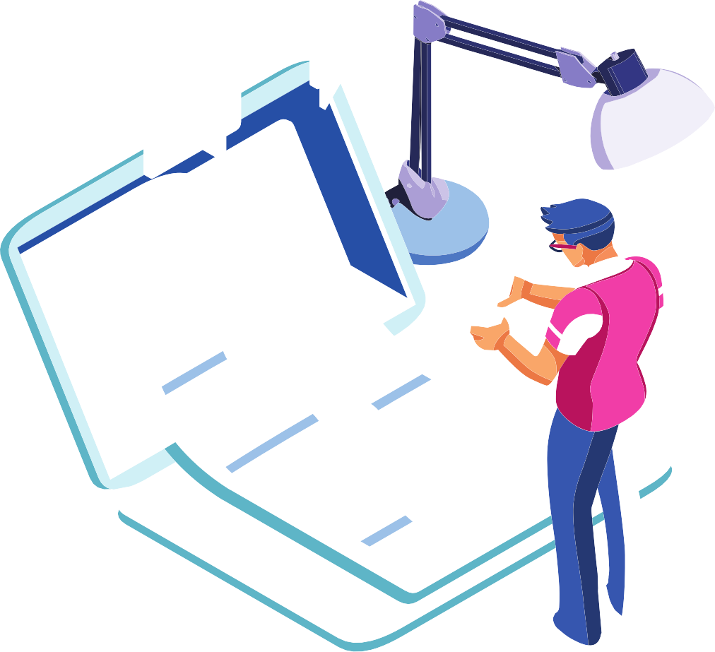


Content
01
Introduction
05
Learning Skill Developed
What is Java
Project Code
Project Output
06
Application

Slide 3
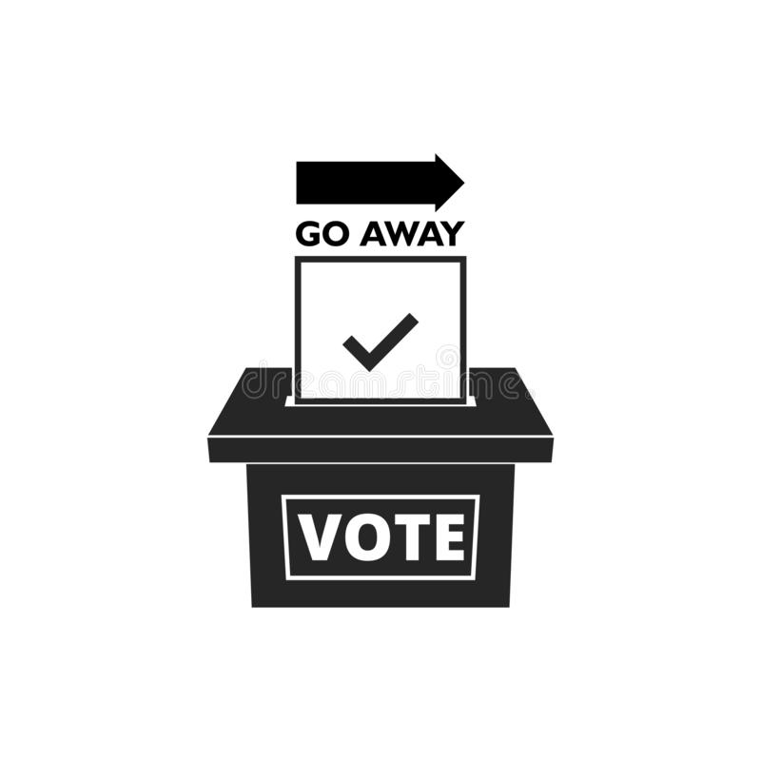
Introduction
Online Voting is a web-based voting system that will help you manage your elections easily and securely. This voting system can be used for casting votes during the elections held in colleges, etc. In this system the voter does not have to go to the polling booth to cast their vote.

Slide 4
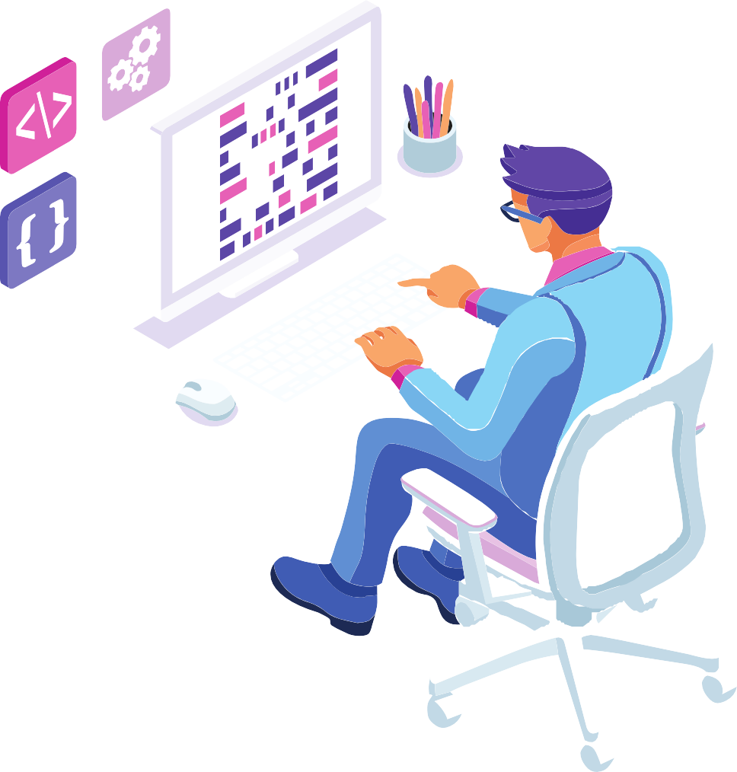




What is java?
Java is a programming language and computing platform first released by Sun Microsystems in 1995.
One of the most widely used programming languages.
Java is Platform Independent language.

Slide 5










Program code
import java.awt.*;
import java.applet.*;
import java.awt.event.*;
public class VotingSystem extends Applet
{
public int count1;
public int count2;
public int count3;
public int count4;
public int count5;
public int count6;
public int count7;
public int count8;

Slide 6
Program code
public Button vote;
TextField anc;
TextField np;
TextField ifp;
TextField azapo;
TextField udm;
TextField dp;
TextField kiss;
TextField pac;
public void init()
{
count1 = 0;
count2 = 0;
count3 = 0;

Slide 7
Program code
count4 = 0;
count5 = 0;
count6 = 0;
count7 = 0;
count8 = 0;
this.setBackground(Color.yellow);
setLayout(new BorderLayout());
Panel p1 =new Panel();
p1.setBackground(Color.lightGray);
p1.setLayout(new GridLayout(8,2,3,2));
Checkbox ch1 =new Checkbox("National Party");
Checkbox ch2 =new Checkbox("African National Congress");
Checkbox ch3 =new Checkbox("Democratic Party");
Checkbox ch4 =new Checkbox("Inkatha Freedom Party");

Slide 8
Program code
Checkbox ch5 =new Checkbox("United Democratic Movement");
Checkbox ch6 =new Checkbox("Pan africanist Congress");
Checkbox ch7 =new Checkbox("Azanian People Organization");
Checkbox ch8=new Checkbox("Freedom Front");
anc = new TextField("Anc:" + String.valueOf(count1));
anc.setEditable(false);
np = new TextField("Np:" + String.valueOf(count2));
dp = new TextField("Dp" + String.valueOf(count3));
dp.setEditable(false);
ifp = new TextField("Ifp:" + String.valueOf(count4));
ifp.setEditable(false);

Slide 9
Program code
pac = new TextField("Pac:" + String.valueOf(count5));
pac.setEditable(false);
azapo = new TextField("Azapo:" + String.valueOf(count6));
azapo.setEditable(false);
kiss = new TextField("FF:" + String.valueOf(count7));
kiss.setEditable(false);
udm = new TextField("Udm:" + String.valueOf(count8));
udm.setEditable(false);
handlenp npp = new handlenp();
p1.add(ch1);
ch1.addItemListener(npp);
p1.add(np);
handleanc ancc = new handleanc();

Slide 10
Program code
p1.add(ch2);
ch2.addItemListener(ancc);
p1.add(anc);
handledp dpp = new handledp();
p1.add(ch3);
ch3.addItemListener(dpp);
p1.add(dp);
handleifp ifpp = new handleifp();
p1.add(ch4);
ch4.addItemListener(ifpp);
p1.add(ifp);
handleudm udmm = new handleudm();
p1.add(ch5);
ch5.addItemListener(udmm);

Slide 11
Program code
p1.add(udm);
handlepac pacc = new handlepac();
p1.add(ch6);
ch6.addItemListener(pacc);
p1.add(pac);
handleazapo azapoo = new handleazapo();
p1.add(ch7);
ch7.addItemListener(azapoo);
p1.add(azapo);
handlekiss kisses = new handlekiss();
p1.add(ch8);
ch8.addItemListener(kisses);
p1.add(kiss);

Slide 12
Program code
ch7.addItemListener(azapoo);
p1.add(azapo);
handlekiss kisses = new handlekiss();
p1.add(ch8);
ch8.addItemListener(kisses);
p1.add(kiss);
add("North",p1);
Label l =new Label("Click choose the Party");
Font f = new Font("Helvetica",Font.BOLD,32);
l.setFont(f); add("Center",l);
SingleAction sa = new SingleAction();
vote =new Button("Count number of votes");
vote.addActionListener(sa);

Slide 13
Program code
add("South",vote);
}
class handleanc implements ItemListener
{
public void itemStateChanged(ItemEvent ie)
{
if(ie.getStateChange()==ItemEvent.SELECTED)
count1++;
}
}
class handlenp implements ItemListener
{
public void itemStateChanged(ItemEvent ie)

Slide 14
Program code
{
if(ie.getStateChange()==ItemEvent.SELECTED)
++count2;
}
}
class handlepac implements ItemListener
{
public void itemStateChanged(ItemEvent ie)
{
if(ie.getStateChange()==ItemEvent.SELECTED)
++count3;
}
}

Slide 15
Program code
class handledp implements ItemListener
{
public void itemStateChanged(ItemEvent ie)
{
if(ie.getStateChange()==ItemEvent.SELECTED)
++count4;
}
}
class handleudm implements ItemListener
{
public void itemStateChanged(ItemEvent ie)
{
if(ie.getStateChange()==ItemEvent.SELECTED)
++count5;

Slide 16
Program code
}
}
class handlekiss implements ItemListener
{
public void itemStateChanged(ItemEvent ie)
{
if(ie.getStateChange()==ItemEvent.SELECTED)
++count6;
}
}
class handleifp implements ItemListener
{
public void itemStateChanged(ItemEvent ie)

Slide 17
Program code
{
if(ie.getStateChange()==ItemEvent.SELECTED)
++count7;
}
}
class handleazapo implements ItemListener
{
public void itemStateChanged(ItemEvent ie)
{
if(ie.getStateChange()==ItemEvent.SELECTED)
++count8;
}
}

Slide 18
Program code
class SingleAction implements ActionListener
{
public void actionPerformed(ActionEvent e)
{
anc.setText("Anc :" + String.valueOf(count1));
np.setText("Np :" + String.valueOf(count2));
pac.setText("Pac :" + String.valueOf(count3));
dp.setText("Dp :" + String.valueOf(count4));
udm.setText("Udm :" + String.valueOf(count5));
kiss.setText("FF :" + String.valueOf(count6));
ifp.setText("Ifp :" + String.valueOf(count7));
azapo.setText("Azapo :" + String.valueOf(count8));
}
}
}

Slide 19
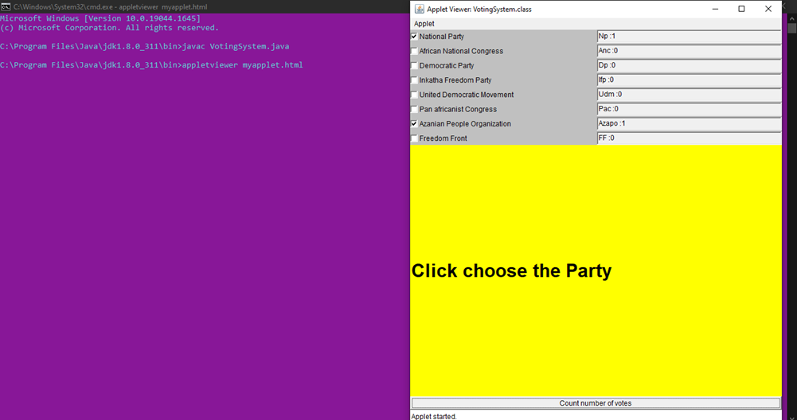
Output

Slide 20







Learning Skills Development
01
Searching and collecting the information.
02
Arranging the information in proper sequence.
Learned the concept of Java Applets
Presenting information effectively.
03
04

Slide 21
Application
01
Fast and easy way of conducting Election.
02
Reduce the cost of paying staff to count votes manually and can provide improved accessibility for disabled voter
03
Electronic voting technology intends to speed the counting of ballots

Slide 22
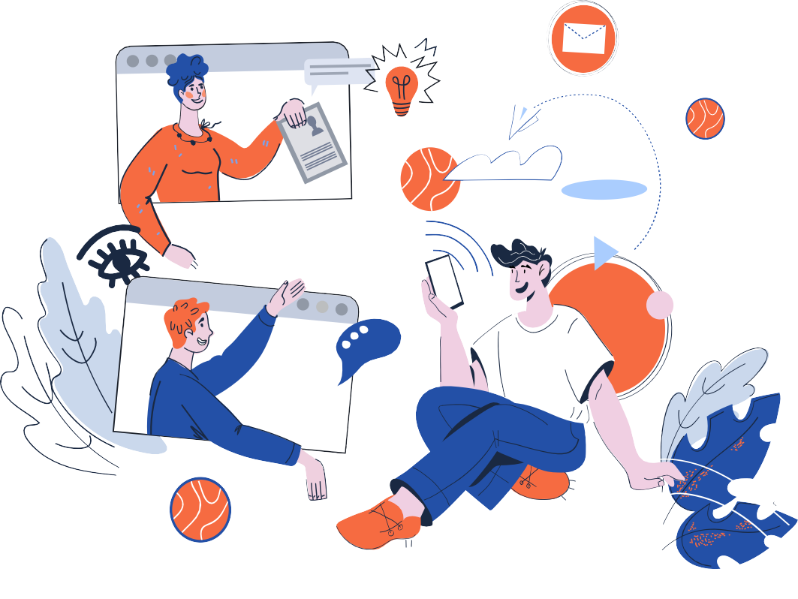
Thank You

